Slide 1
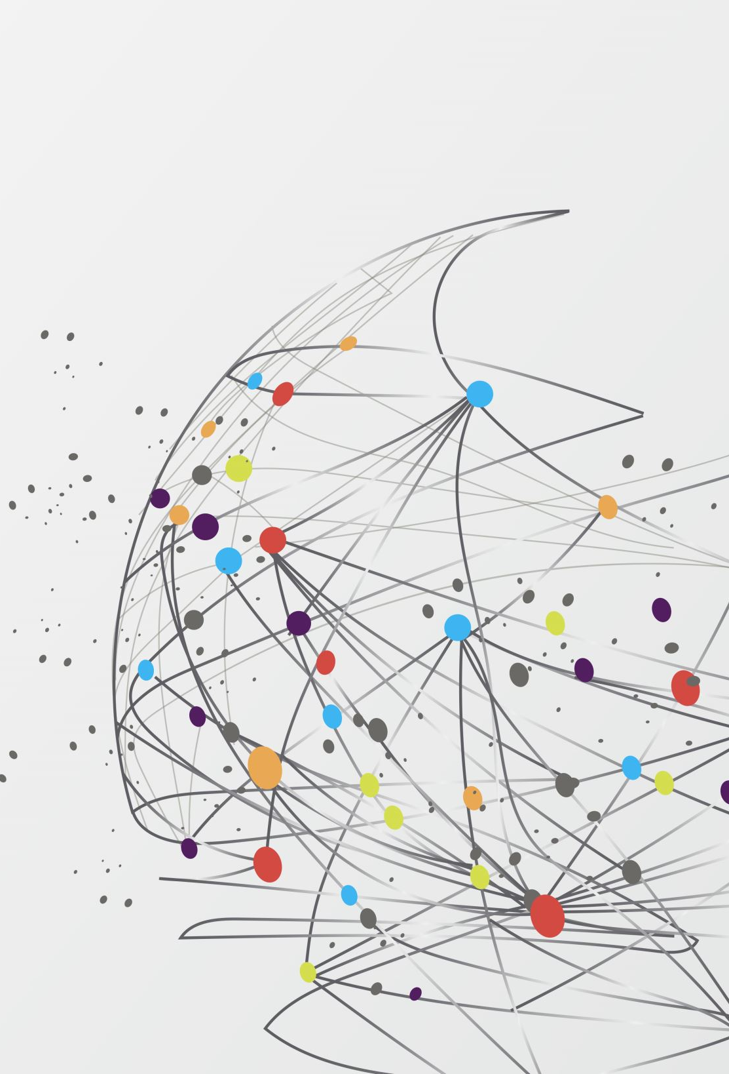
Approaches to Recommender Systems in Media & Entertainment
By Siddharth Mandgi…………………………
Under Prof. Hong Man………………………

Slide 2
Index
Introduction to Recommender Systems
Case Studies of Recommender Systems in Media
Approaches to Recommender Systems
Results
Conclusion & Future Scope
Dataset Description
Project Flow

Slide 3
Introduction to Recommender Systems

Slide 4


Introduction to Recommender Systems
Recommender Systems are AI algorithms that generally use Machine Learning to recommend consumers with items which are closest to their purchased, reviewed or viewed product.
The goal of recommender systems is to suggest the most relevant and personalized products to the consumer keeping his/her needs as a priority but at the same time generating maximum profits.

Slide 5
Introduction to Recommender Systems
In the media industry, giants such as Netflix, Spotify and YouTube recommend media based on millions of user’s likes, views or comments on videos, music or movies or other features such as view timings, genre or type, name of the artists, actors or producers.
The different kinds of Recommender Systems we will speak about in this research are as follows: -
Content Based Filtering
Collaborative Filtering
Weighted Averages
ALS (Alternating Least Squares) based on PySpark

Slide 6
Case Studies of Recommender Systems in Media

Slide 7
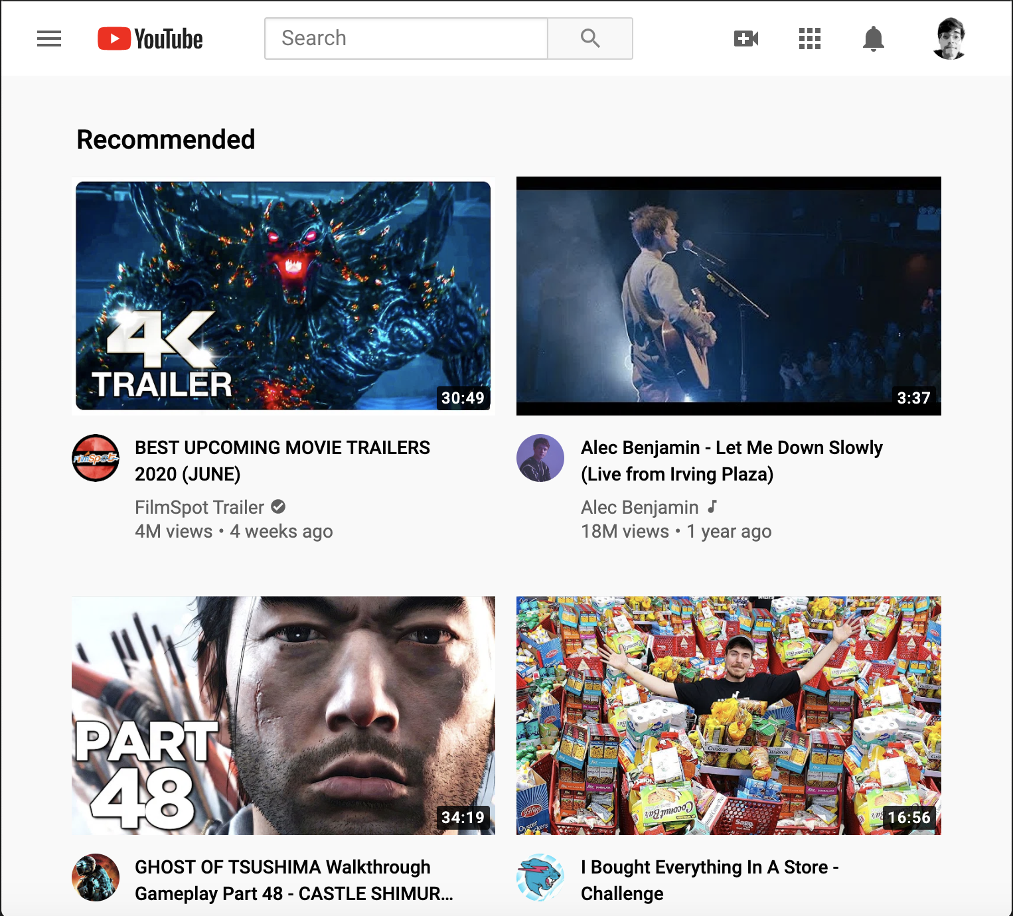
Case Studies of Recommender Systems in Media
YouTube

Slide 8
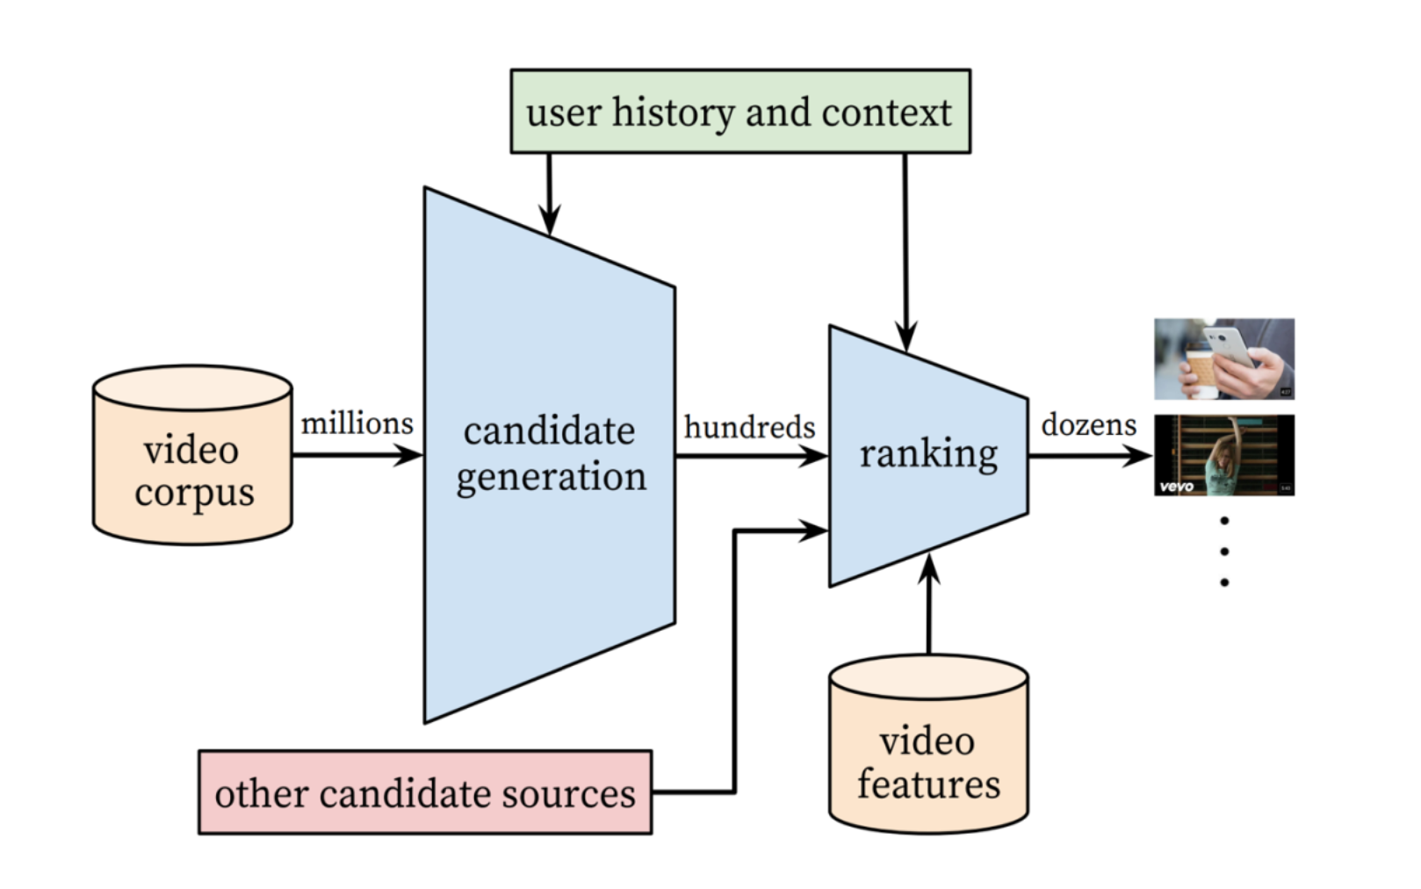
Case Studies of Recommender Systems in Media
YouTube has a Two Stage Process for Recommending videos to its users.
Candidate Generation and Ranking.
Candidate Generation Algorithm takes millions of videos available on the platform and filters out the videos that the user may like.
Ranking Algorithm sorts the videos selected by the former algorithm and sorts them in order of relevance.
Notes:
Candidate Generation and Ranking Algorithms are basically Neural Networks.
In the candidate generation algorithm user features are fed into the neural network in terms of vectors which then generates a set of recommended videos.
For the output in case of the Ranking Algorithm, YouTube does not consider every single output generated since SoftMax in the above network would provide a probability of whether the video was watched completely or not which would imply having an output for every single video, a count which could be in billions. Instead YouTube uses an Algorithm called Candidate Sampling, where only a subset of the entire output is considered by a method called sampling.
Link: https://static.googleusercontent.com/media/research.google.com/en//pubs/archive/45530.pdf

Slide 9

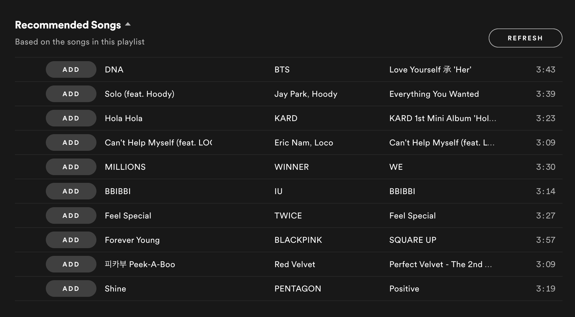
Case Studies of Recommender Systems in Media
2. Spotify

Slide 10
Case Studies of Recommender Systems in Media
There are three recommendation models at work on Spotify:
Collaborative Filtering: This model uses “nearest neighbors” to make predictions about what other users might enjoy.
Natural Language Processing: - Spotify identifies the co-location of individual terms and uses this to predict the meaning of phrases.
Audio Models: - Spotify uses the kind of neural network that is employed by search engines to understand the contents of images. These networks process raw audio to produce a range of characteristics, including key, tempo, and even loudness. We have explored these models to recommend tracks based on our Spotify Models.

Slide 11


Case Studies of Recommender Systems in Media
3. Netflix

Slide 12
Case Studies of Recommender Systems in Media
Netflix estimates the likelihood using Collaborative Filtering that the user will watch a movie in their catalog based on number of factors including:
The user interactions with the platform (such as your viewing history and how you rated other titles).
Other users with similar tastes and preferences on our service.
Information about the titles, such as their genre, categories, actors.
Year of release.
Netflix adds a lot of personalization in their recommender systems to produce top notch results which have completely disrupted the way TV and media industry operates.

Slide 13
Dataset Description

Slide 14
Dataset Description
For our research we have used several datasets for training our models and validation they are listed below
Amazon Movies Dataset.
IMDB Reviews Dataset.
Spotify Playlist with audio features (spotipy API).

Slide 15
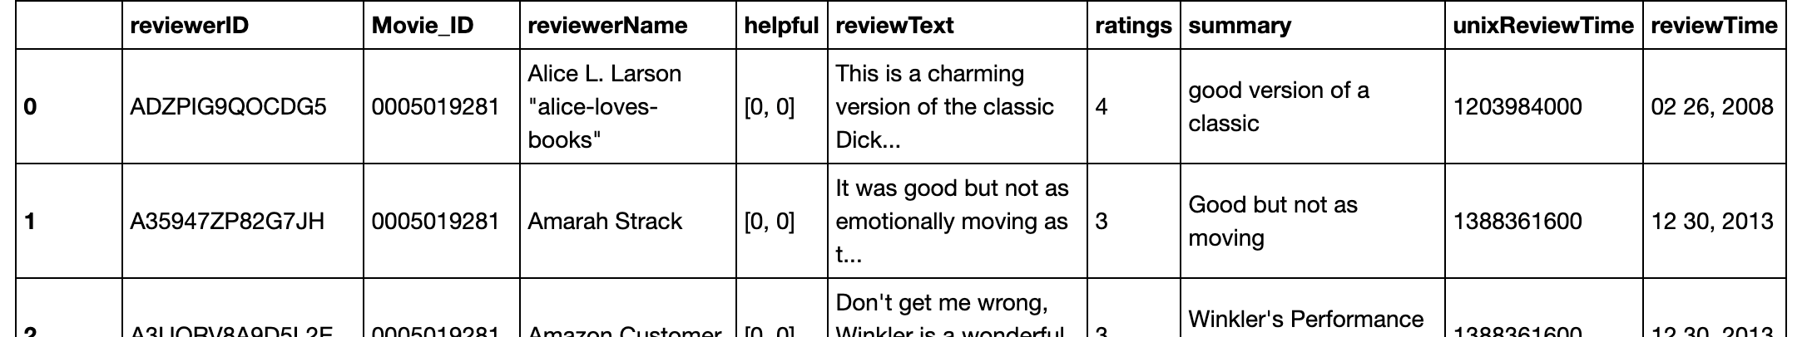
Dataset Description
1. AMAZON MOVIES DATSASET

Slide 16
Dataset Description
The most important features we will be using during our research from this dataset are: -
reviewerID – This feature signifies the ID of every user.
Movie_ID – This feature signifies the ID of every movie.
reviewText – The comment left behind by every user.
ratings – Ratings provided by user. (On a scale of 1-5).
Sentiments – Our custom variable that signifies the sentiment of every comment (Positive, Negative and Neutral).

Slide 17
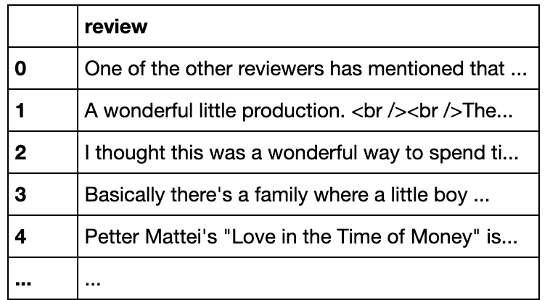
Dataset Description
2. IMDB DATASET
This dataset contains 5000 movie reviews left by users.
We use this dataset to generate our ratings and sentiment predictions.

Slide 18
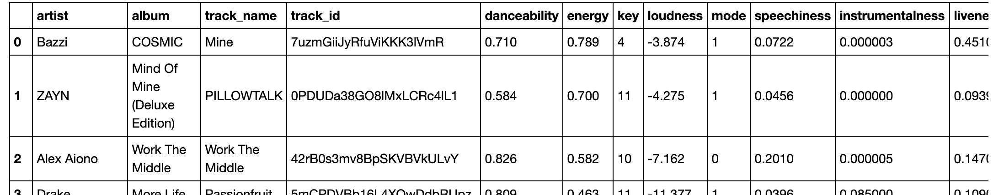
Dataset Description
3. Spotify
This dataset is imported using the spotipy API using the Spotify Developer Account.

Slide 19
Dataset Description
The audio features are as follows:-
Danceability: Danceability describes how suitable a track is for dancing based on a combination of musical elements including tempo, rhythm stability, beat strength, and overall regularity. A value of 0.0 is least danceable and 1.0 is most danceable.
Energy: Energy is a measure from 0.0 to 1.0 and rep- resents a perceptual measure of intensity and activity. Typically, energetic tracks feel fast, loud, and noisy.
Instrumentalness: Predicts whether a track contains no vocals. The closer the instrumentalness value is to 1.0, the greater likelihood the track contains no vocal content.

Slide 20
Dataset Description
Liveness: Detects the presence of an audience in the recording. Higher liveness values represent an increased probability that the track was performed live.
Loudness: The overall loudness of a track in decibels (dB). Loudness values are averaged across the entire track. Values typical range between -60 and 0 db.
Speechiness detects the presence of spoken words in a track. The more exclusively speech-like the recording (e.g. talk show, audio book, poetry), the closer to 1.0 the attribute value.

Slide 21
Dataset Description
Tempo: The overall estimated tempo of a track in beats per minute (BPM). In musical terminology, tempo is the speed or pace of a given piece and derives directly from the average beat duration.
Valence: A measure from 0.0 to 1.0 describing the musical positiveness conveyed by a track. Tracks with high valence sound more positive (e.g. happy, cheerful, euphoric), while tracks with low valence sound more negative (e.g. sad, depressed, angry).

Slide 22
Project Flow

Slide 23
Project Flow
Data Preprocessing: Every approach had a different set of preprocessing steps which included cleaning the dataset, creating sentiments and reforming our ’review’ feature with spaCy for Content Based Filtering with NLP and counting the no of reviews per movie, popularity threshold, building pivot tables and sparse matrix for Collaborative Filtering.
Training: For training, we have used different algorithms for different approaches. For Content Based Filtering we have explored Logistic Regression with spaCy pipelines and LSTM based Neural Nets. For Collaborative Filtering we have used K-Nearest Neighbors (KNN) and PySpark based ALS (Alternating Least Squares) model.
Testing: After training our models, we evaluate our pre- dictions on our test datasets. We have also generated music recommendations by training Spotify playlists and movie recommendations on IMDB.

Slide 24


Approaches to Recommender Systems

Slide 25
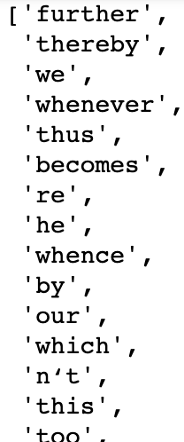
Content Based Filtering with Logistic Regression
Content-based filtering uses item features to recommend similar items for users based on their previous actions or explicit feedback. In this approach we make use of textual reviews of movies from the Amazon Movie Dataset and apply natural language processing to predict sentiments which is then used to generate recommendations for users.
Data Preprocessing - We use spaCy for NLP techniques such as importing stop words, tokenizations and transformation. Stopwords are the words in any language which does not add much meaning to a sentence. They can safely be ignored without sacrificing the meaning of the sentence.

Slide 26
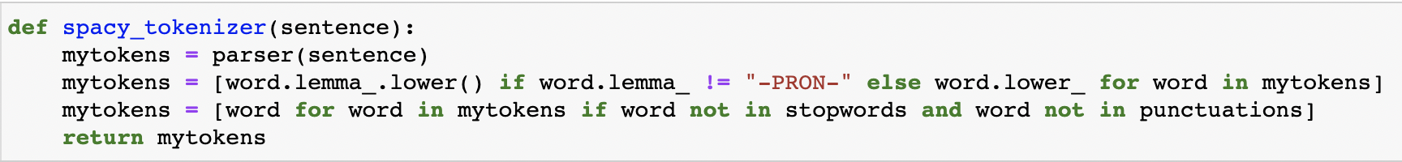
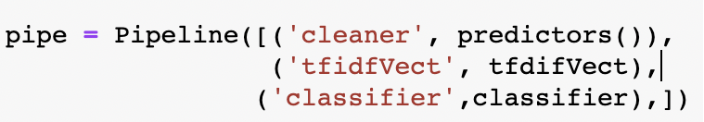
Content Based Filtering with Logistic Regression
We then build a custom spaCy tokenizer function to create tokens for our reviews and at the same time remove punctuations and convert all words to lower cases.
We then split our data into train and test datasets (where X contains reviews and y contains our ratings/sentiments) and pass it through a Scikit-Learn based Pipeline which contains a tfidf vectorizer , transformer and a Logistic Regression based classifier.
The application of a pipeline is to transform, apply vectorizers and classify every sample of data simultaneously saving time and computational power.

Slide 27
Content Based Filtering with LSTM
Long Short-Term Memory (LSTM) networks are a type of recurrent neural network capable of learning order dependence in sequence prediction problems. LSTMS are required for complex problem domains like machine translation, speech recognition, and more.
All recurrent neural networks have the form of a chain of repeating modules of neural network. In standard RNNs, this repeating module will have a very simple structure, such as a single tanh layer.
LSTMs also have this chain like structure, but the repeating module has a different structure. Instead of having a single neural network layer, there are four, interacting in a very special way.
We will be using LSTMs for generating content-based recommendations.

Slide 28


Content Based Filtering with LSTM
General Architecture for RNN
General Architecture for LSTM

Slide 29
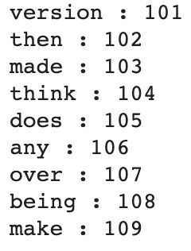
Content Based Filtering with LSTM
The data preprocessing for this approach is similar to Content Based Filtering with Logistic Regression approach.
We split the reviews into bag of words while removing punctuations and stop words and count the number of times the words have repeated using our own custom CountVectorizer. Based on these repetitions we form a bag of words by encoding them by their order of repetitions (most to least).

Slide 30
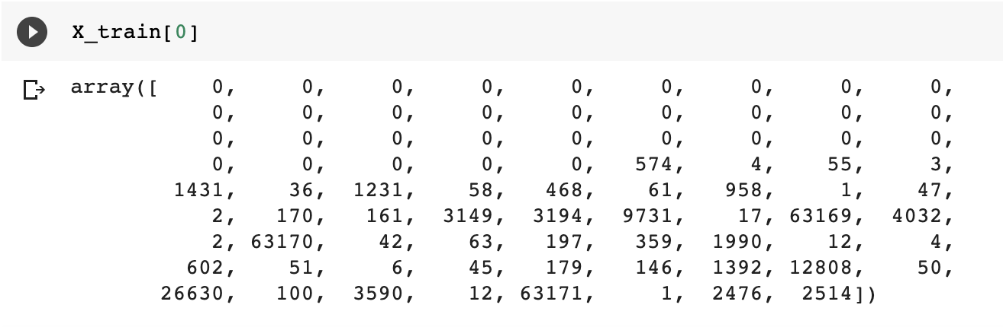
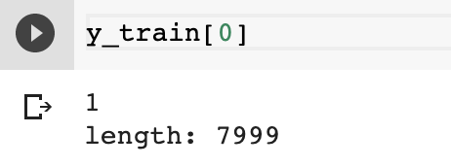
Content Based Filtering with LSTM
We then pad our training and testing dataset. This is necessary since if one uses the batch mode, all sequences must be of the same length inside your batch.
The training dataset is then fed to LSTM model which has a sigmoid activation function, cross entropy loss function and adam optimizer to generate recommendations.

Slide 31
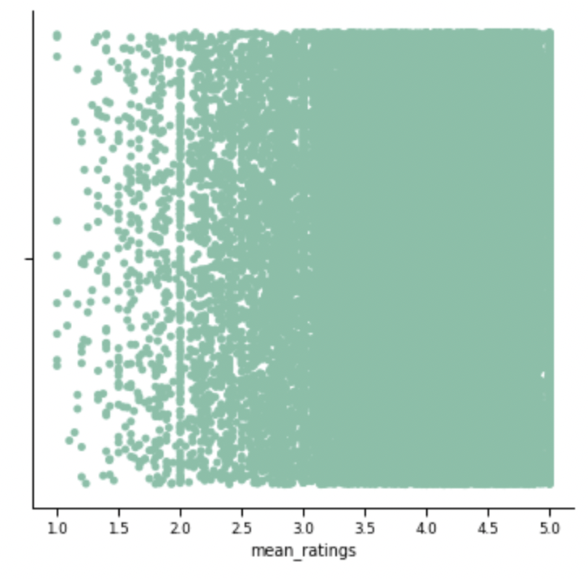
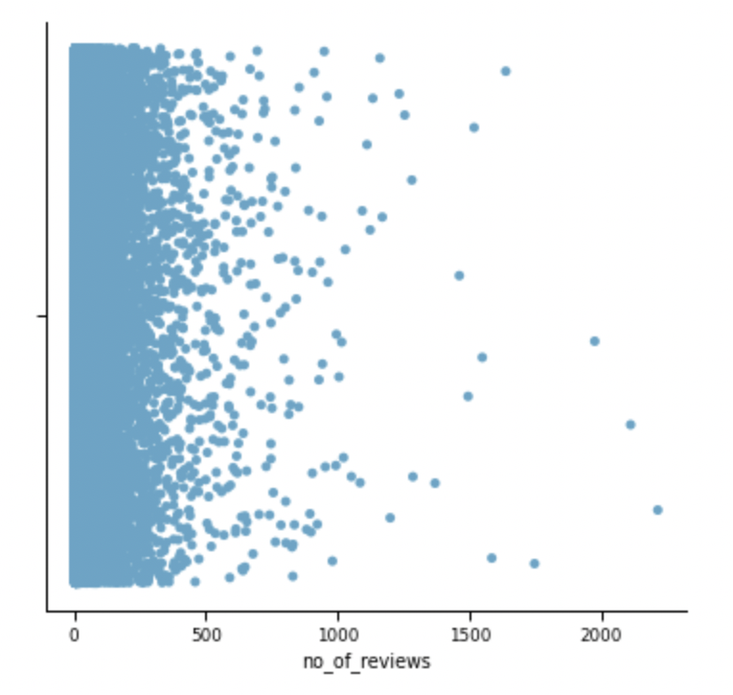
Collaborative Filtering with KNN
Collaborative filtering uses algorithms to filter data from user reviews to make personalized recommendations for users with the most similar preferences. There are several types of Collaborative Filtering, in this research we will be focusing on Neighbor based Filtering.
In neighbor-based filtering, users are selected for their similarity to the active user. This similarity is determined by matching users who have posted similar reviews.
For Data Preprocessing, we create a count variable to count the no of reviews for each movie id along with mean ratings variable to generate the mean ratings for each movie and music track.

Slide 32
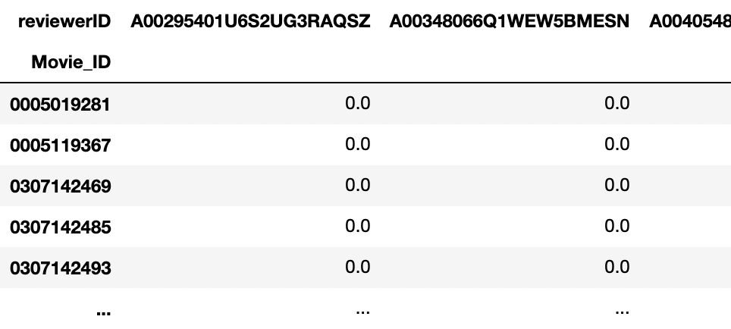
Collaborative Filtering with KNN
From EDA and previous plots, we find that Movie ID B003EYVXV4 has the max total no of reviews= 2213 and a mean rating = 4.11528 making it the most popular movie.
We then define a popularity threshold which is a limit below which if the value of the number of reviews for a movie fall, they will not be considered.
We then create pivot tables give each users rating for each movie. The majority of these samples are filled with zeros that will later be replaced by the users predicted rating.

Slide 33
Collaborative Filtering with KNN
Pivot table occupies a lot of space when it comes to training a model hence, we use sparse matrix which only contains nonzero ratings. We use a scikit-learn based KNN model to train our training dataset and generate recommendations.
For this approach we have also generated rating recommendations for the IMDB reviews dataset.

Slide 34
Collaborative Filtering with ALS
ALS or the Alternating Least Square Model a matrix factorization algorithm and it runs itself in a parallel fashion. ALS is implemented in Apache Spark ML and built for a larges-scale collaborative filtering problems.
ALS is doing a pretty good job at solving scalability and sparseness of the Ratings data, and it’s simple and scales well to very large datasets.
In our approach we have used the ALS model in PySpark to generate Recommendations.

Slide 35
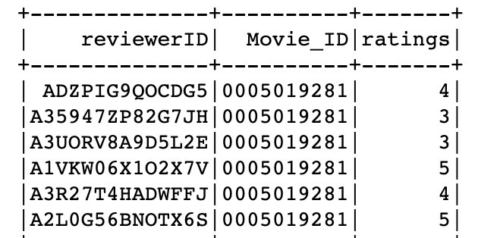
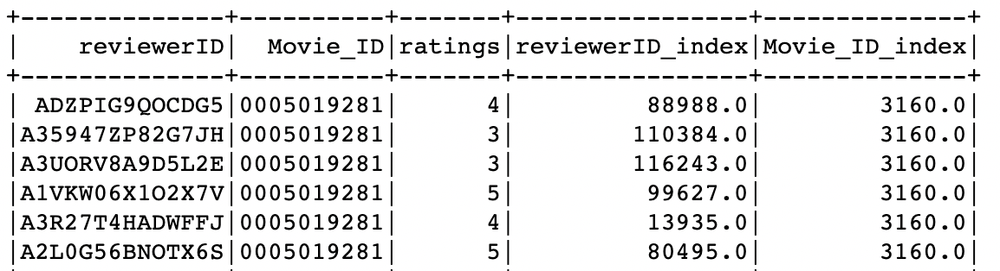
Collaborative Filtering with ALS
We begin by first creating a spark session and allocating memory size
We then read the csv into a Spark DataFrame.
For ALS we need to ensure that all our features are integers. Hence, we need to create indexes for reviewerID, Movie ID and ratings. This is done by a StringIndexer in PySpark. This creates indexes for Movie ID and reviewerID.
These features are then used to generate predictions and in turn generate recommendations using RegressionEvaluator and Pyspark based ALS model.

Slide 36
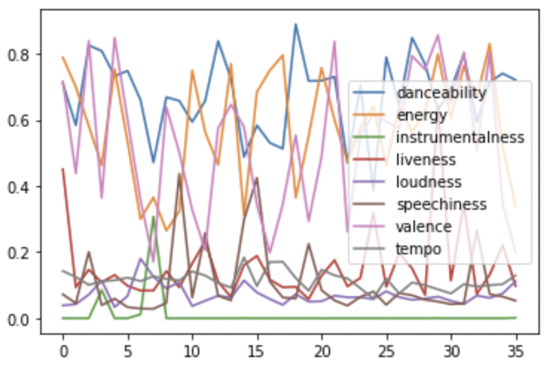
Spotify Recommender Engine
We have already spoken about the different Spotify audio features in our dataset description.
Rescaling these features we can compare and analyze them and the user’s preferences for a playlist.

Slide 37
Spotify Recommender Engine
We create a custom function based on the spotipy API to import our playlists from Spotify along with its audio features (such as loudness, valence, acousticity, etc.) along with artist name, album name and song name.
These features are rescaled and hypertuned to understand what kind of music does the user prefer.
This playlist suggests that the user likes music that has a high danceability and energy along with songs which have a high tempo. Valence suggests if the user has a positive outlook or negative outlook to music. In this case the user likes music that is more positive and livelier. Loudness values in this playlist suggests that the user likes softer music.
These results are then used to generate recommendations.

Slide 38
Results

Slide 39
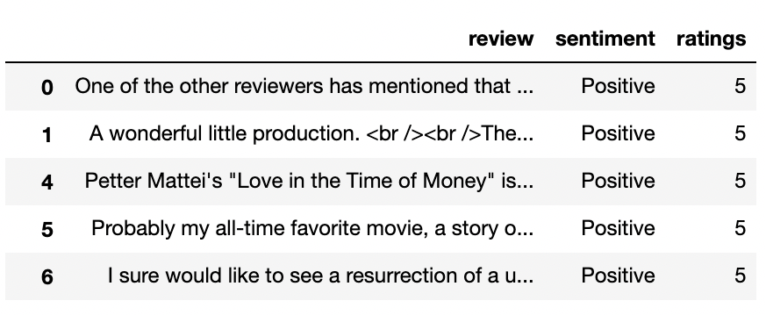
Results
For the Content Based Filtering
Our Logistic Regression our model yielded a Validation Accuracy of 0.8526 and we have applied this model to generate recommendations for IMDB reviews.
LSTM on the other hand yielded an accuracy of 0.769.

Slide 40
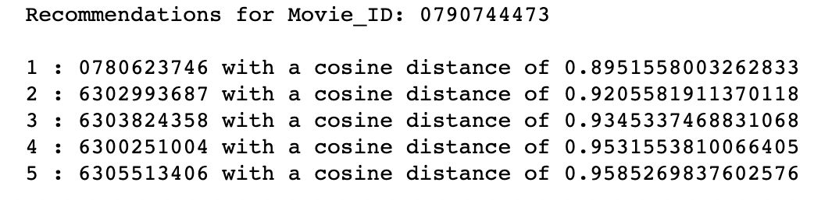
Results
KNN gives the most similar (nearest neighbors) items (in our case movies) based on a distance metrics. In our case we have considered a cosine distance metrics. Based on this metric we have generated top 5 recommendations.
The best-case scenario: Cos0 = 1 which implies maximum similarity and the worst-case scenario: Cos90 = 0 which implies maximum dissimilarity. Our distance values are around 0.95 (closer to 1) which implies that our recommendations are very similar in features to our reviewed movie.

Slide 41
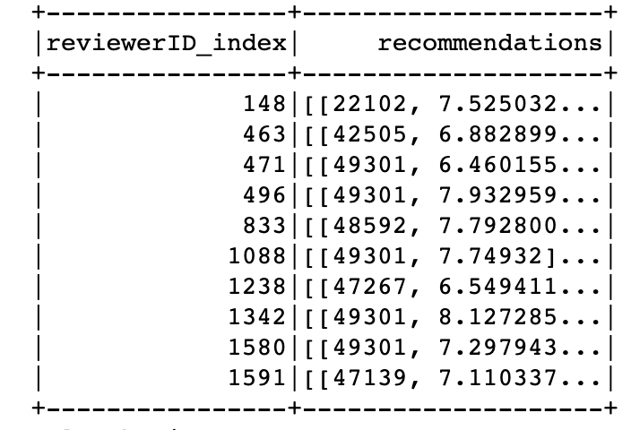
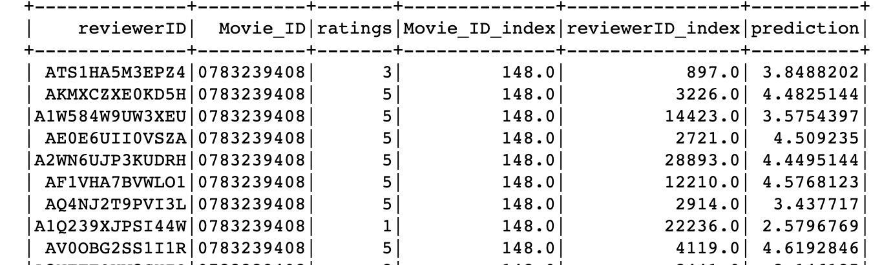
Results
ALS based PySpark model has lowest computational time and is by far the fastest model to train because of parallel computing.

Slide 42
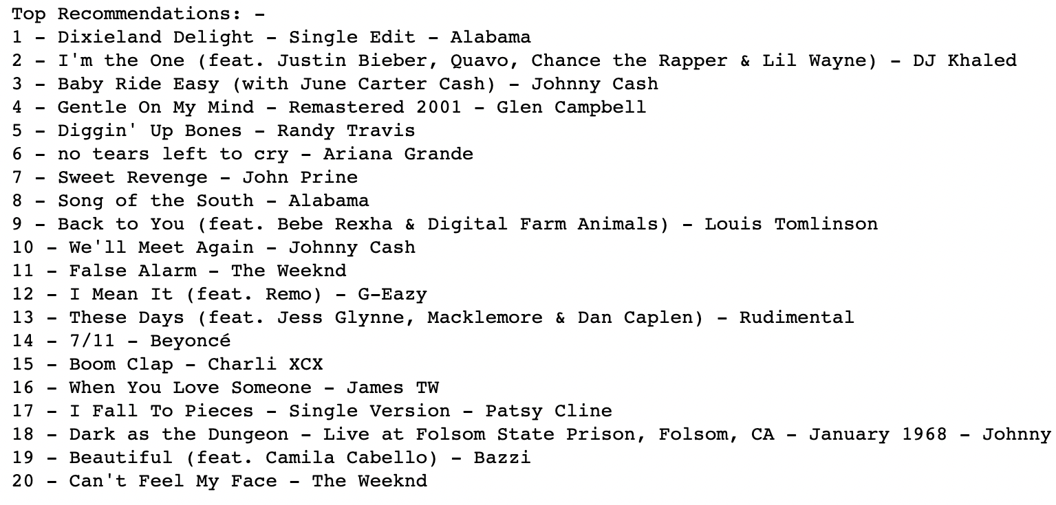
Results
Exploring the features of a playlist we find that user has inclined taste towards tracks that have a high danceability and energy along with tracks which have a high tempo. The user prefers music that is more positive and livelier and is softer. Based on these decisions we have recommended 20 Tracks.

Slide 43
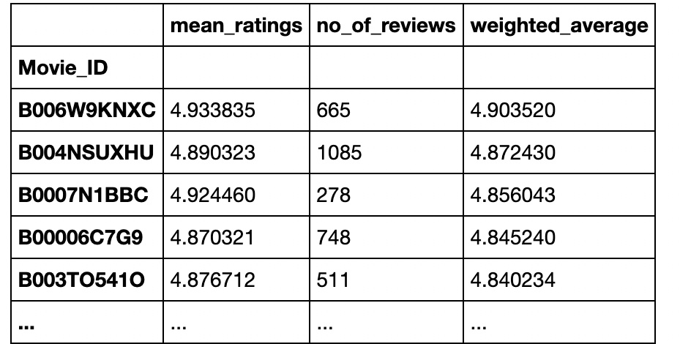
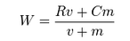
Results
IMDB Weighted Average Algorithm was also used along with collaborative filtering to generate recommendations based on max weighted average ratings.
The algorithm

Slide 44
Conclusion and Future Scope

Slide 45
Conclusion
Recommender Systems are an important application of AI and through this project I have tried to explore in depth about the different approaches to recommend more personalized music or videos.
I have also tried to deep dive methods used by organizations in the Entertainment Industry to recommend content to users to keep them hooked. I hope to continue to explore more about recommender systems in the future.

Slide 46
Future Scope
Content Creator’s Perspective - A further point of research could be to look at the content creator’s perspective for recommendation systems. In the media and entertainment industry which genre of music or a type of music is currently popular among listeners. This can help many young artists reach and appeal to a larger audience. Similarly for movies and videos. AI can help producers gauge the audience interests and help make commercial films which have a larger appeal.
Image Processing - Images give a lot of information of the data. For example movie posters can be processed and categorized into a genre and new movies could be recommended based on these genres.

Slide 47

Thank You

